Slide 1


Turas
The complete survey analytics system

Slide 2
WHAT IS TURAS?
01
Your Research Should Work Harder
Good Data, Limited Life
You commission research and get a deck that answers the questions you asked at the time.
New Questions, Old Process
When a new question surfaces, someone has to reopen the dataset and rebuild the analysis. That takes time and money.
Turas Changes That
Most research ends up as a presentation rather than a resource.

Slide 3
THE CASE FOR TURAS
02
What Turas Delivers
Interactive Analytics
An interactive resource your team can explore, share, and return to.
Rigorous Statistics
Built on validated, open-source statistical methods — not proprietary algorithms.
Permanent Record
One dataset. One report. Useful for as long as the data is relevant.
Pay Per Project
No subscriptions. No licence costs. No installations.
Bring Your Own Data
Works with any survey dataset, whether fieldwork was commissioned through us or not. Got old data gathering dust? We can re-run it through Turas and discover insights you never got to.
World-class analytics on demand. No strings attached

Slide 4
THE STATISTICS
03
Serious Statistical Foundations
━━━
Built on R
The open-source statistical environment used by national statistics offices, central banks, and universities worldwide.
━━━
Fully Transparent
Every calculation is inspectable. Methods can be examined and verified.
━━━
No Black Boxes
When a finding is challenged, you have a clean, traceable analytical record to stand behind.
Every result traces directly back to the underlying tables

Slide 5
WHO'S BEHIND IT
04
Professional Oversight
Turas is not a self-service tool
━━━
SAMRA Accredited
The Research LampPost is an organisational member of the Southern African Marketing Research Association.
Duncan Brett developed Turas and is a SAMRA-Accredited Researcher.
━━━
Guided End-to-End
Every project is guided from data preparation through to final output. The right methods are applied, data is structured correctly, and results are interpreted responsibly.
30+ years of quantitative market research expertise behind every project

Slide 6
DATA SECURITY
05
Your Data Stays With You
━━━
Completely Handled In-House
Your survey data is analysed entirely within our own environment — the Turas analytical process runs on our own systems, with no third-party platform involved in processing your data.
━━━
Immutable Record
The delivered report is finalised and self-contained — it cannot be altered after the fact.
A stable record of exactly what the data showed at the time of analysis

Slide 7
SPEED & RELIABILITY
06
Fast, Consistent, Dependable
1 Day*
Preliminary output once data is clean and formatted
Weeks
Traditional analysis timeline
*Post data cleaning. Actual turnaround depends on data layout and processing complexity.
Built-in Consistency
Same methods, every time. For tracking studies, results stay comparable across waves.
Controlled computational environment. Reproducible results. Every time

Slide 8
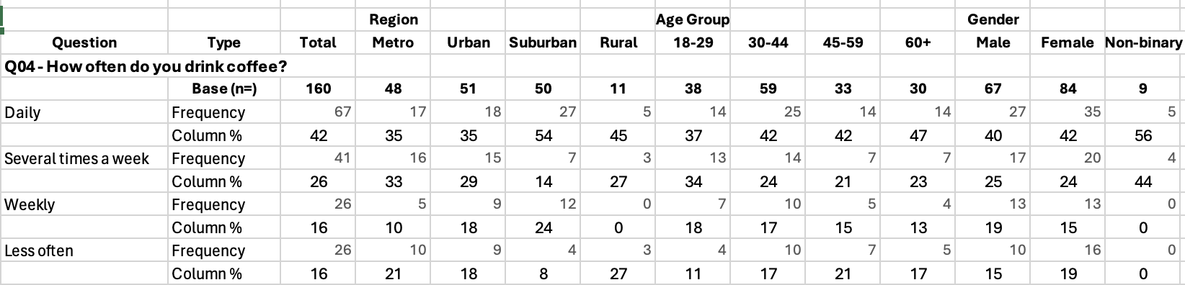
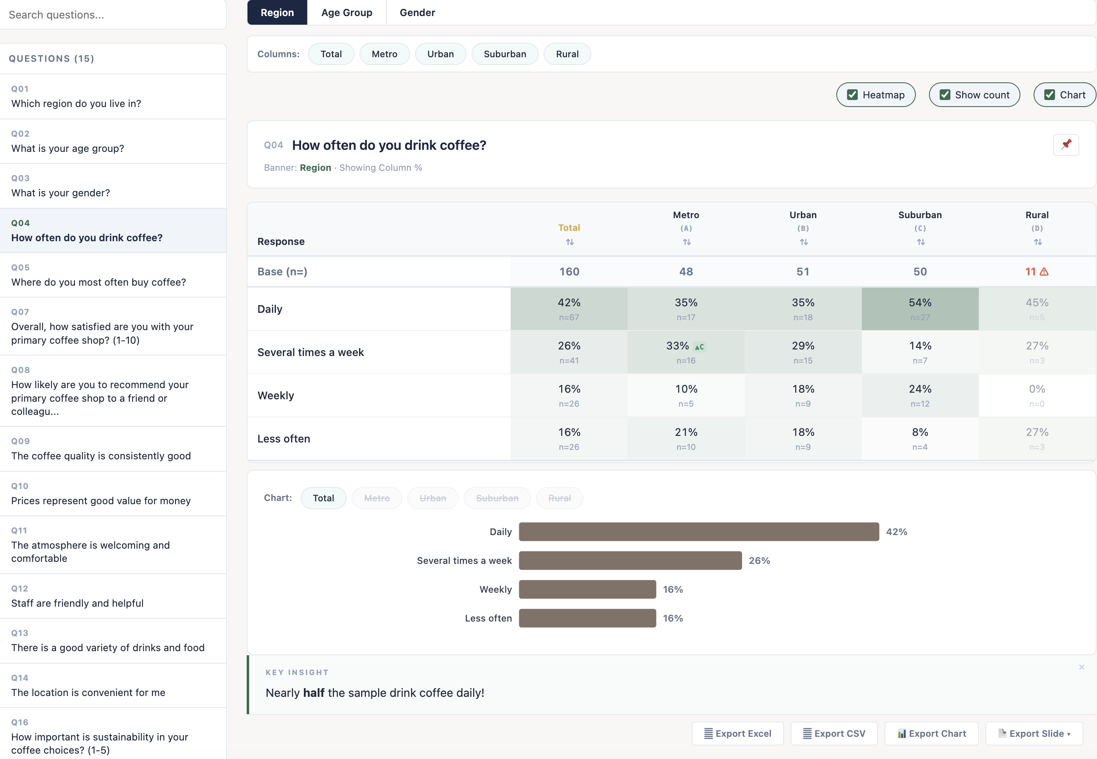
THE DIFFERENCE
07
See for yourself
From this...
To this...
Static rows and columns that are hard to read
Insights disconnected from the data behind them
Filed away, rarely revisited
➜
Interactive, filterable, explorable tables
Insights your team actually uses
Build & present a narrative without leaving the report
Not a dashboard. Not a PDF. A living report your whole team can explore

Slide 9
THE DELIVERABLE
08
Your Data, Alive
A Turas report isn't a flat file you scroll through. It's an interactive experience — intuitive enough for anyone on your team to explore with minimal training. And when you need to go deeper, specialist analytical modules sit inside the same report.
Static PPT / PDF
✘ Fixed views — what you see is all you get
✘ New question? Ask the analyst, wait days
✘ Sits on a shared drive, rarely reopened
✘ One person’s interpretation, locked in
Turas Interactive Report
✔ Interactive, filterable, explorable tables
✔ Insights your team actually uses
✔ Build and present a narrative without leaving the report
✔ Deeper analysis? It's all in the same report.
Browser-Based
Nothing to install. Open a file and go
Table + Chart Views
Switch between views with one click
Excel Export
Pull any table into Excel whenever you need it
Research your whole team can use

Slide 10
—
THE WORKFLOW
09
Build Your Story
Exploring the data is just the start. With pins, you capture the charts and tables that matter and arrange them into a narrative others can follow.
1
2
3
Explore
Browse the interactive report. Filter, compare and switch views.
Plain-language callouts explain what you're seeing and what it means.
Pin
Save key charts, add commentary and arrange them into a clear narrative
Present
Walk stakeholders through your story in-file, or export to PowerPoint or PDF
You don’t just receive results — you build the story you want to tell.
One environment for exploration, narrative-building, and presentation — no tool-switching required.

Slide 11
THE SYSTEM
10
What Turas Can Analyse
Specialist analytical modules, all delivered within the same interactive report
Tabs
Automated crosstabs with significance testing
Tracker
Multi-wave trend analysis across waves
Key Driver
Strongest factors driving business outcomes
Key Driver (Cat.)
Regression for categorical outcomes
Segment
Statistical clustering for customer groups
Conjoint
Choice modelling with market simulator
MaxDiff
Precise preference rankings with TURF and a simulator
Pricing
Van Westendorp, Gabor-Granger with simulators and monadic models
Weighting
Target population representation
Confidence
Rigorous validity testing
Multiple modules can be combined into a single report.
Advanced modules include plain-language callouts that guide users through the statistics — so the outputs are understood, not just delivered.

Slide 12
WORKING TOGETHER
11
What We Can Help With
━━━
Questionnaire Design
Structuring questions to produce clean, analysable data
━━━
Analytical Planning
Choosing the right methods and structuring the approach
━━━
Data Preparation
Cleaning, coding, and preparing data for rigorous analysis
━━━
Interpretation
Making sense of results and building a clear narrative
━━━
Third-Party Data
We can evaluate and prepare existing datasets for analysis, regardless of source
For most projects we also prepare an initial set of pinned views, giving your team a ready-made starting point

Slide 13
NEXT STEPS
12
See It In Action
The most effective way to understand Turas is a live demonstration.
We can walk through a demo dataset and show how survey data becomes a working analytical resource — from raw data to interactive report.
Let's look at a live report

Slide 14

Turas
Complete analytics. No strings attached
duncan@researchlamppost.co.za

